Slide 1

chicago crime analysis
2022
ThisꢀPhotoꢀbyꢀUnknownꢀAuthorꢀisꢀlicensedꢀunderꢀCCꢀBY-SA

Slide 2

Analysis – Chicago Crime Investigation 2022
• Description wise crime analysis
• Top localities with most criminal activities
• Suggesting wards with most criminal activities
• Crime Rate Trend analysis
• Arrest Rate in Domestic Areas
• Count of Description
• Domestic crimes vs Regions
• Solving cases
• Dashboard

Slide 3
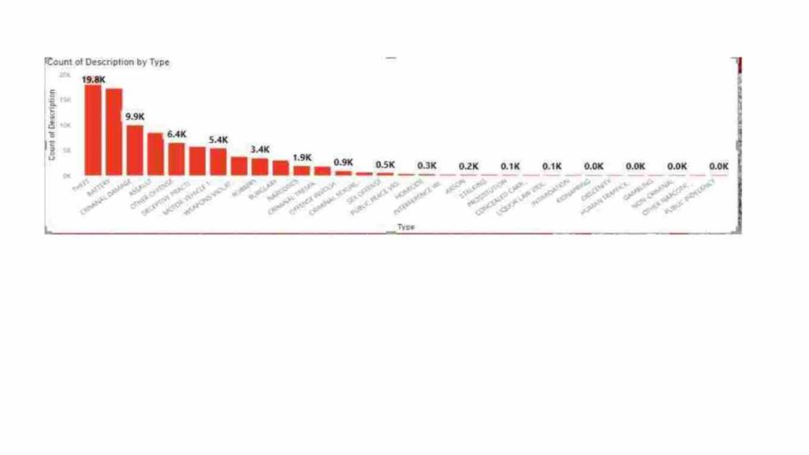
Totalꢀnumberꢀofꢀcrimesꢀisꢀ90k
Let’sꢀfirstꢀlookꢀatꢀcrimeꢀdetailsꢀinꢀChicagoꢀbyꢀdescription
Theꢀ numberꢀofꢀcrimesꢀlikeꢀTheftꢀbatteryꢀcriminalꢀdamageꢀis
veryꢀhigh.
Ifꢀweꢀpayꢀattentionꢀtoꢀtheꢀcrimesꢀmentionedꢀaboveꢀweꢀcan
reduceꢀtheꢀnumberꢀofꢀmajorꢀcrimes.

Slide 4
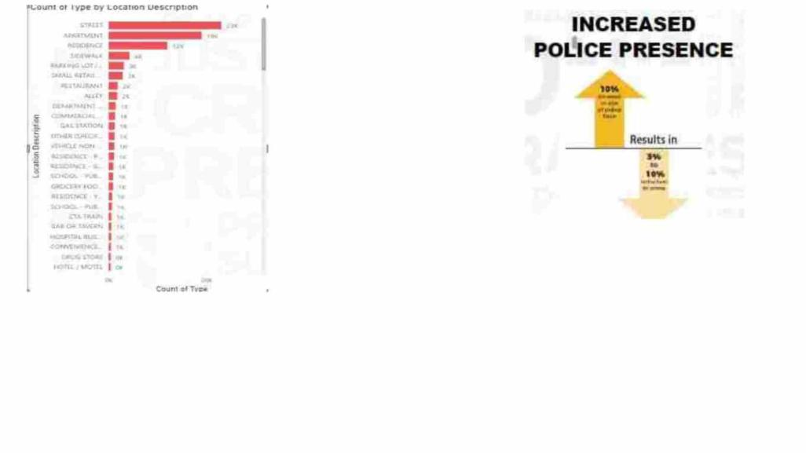
MEASURES:
IncreasedꢀPatrols:
•
Deployꢀadditionalꢀpoliceꢀpatrolsꢀonꢀidentifiedꢀstreets.
•
Conductꢀvisibleꢀpolicingꢀtoꢀdeterꢀcriminalꢀactivities.
ImprovedꢀLighting:
•
Enhanceꢀstreetꢀlightingꢀtoꢀimproveꢀvisibilityꢀatꢀnight.
Theꢀnumberꢀofꢀotherꢀcrimesꢀisꢀmuchꢀlower
thanꢀtheꢀ numberꢀofꢀcrimesꢀinꢀplacesꢀlike
Street,ꢀApartment,ꢀResidence,ꢀSideꢀwalk…
•
Installꢀmotion-sensorꢀlightsꢀinꢀdarkerꢀareas.
CommunityꢀWatchꢀPrograms:
•
Encourageꢀtheꢀformationꢀofꢀcommunityꢀwatchꢀprogramsꢀonꢀtargetedꢀstreets.
Fosterꢀcollaborationꢀbetweenꢀresidentsꢀandꢀlawꢀenforcement

Slide 5
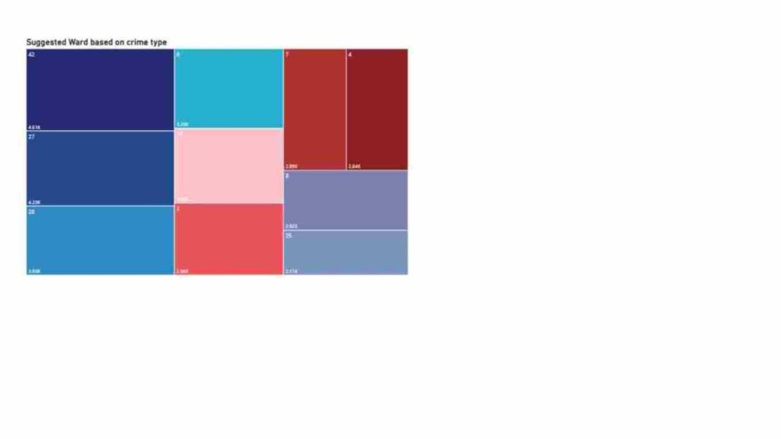
• Suggested wards are:
42,27,286,24,3,7,4,8,25
• The crime rat in other wards
is much lower than in the
above mentioned wards

Slide 6
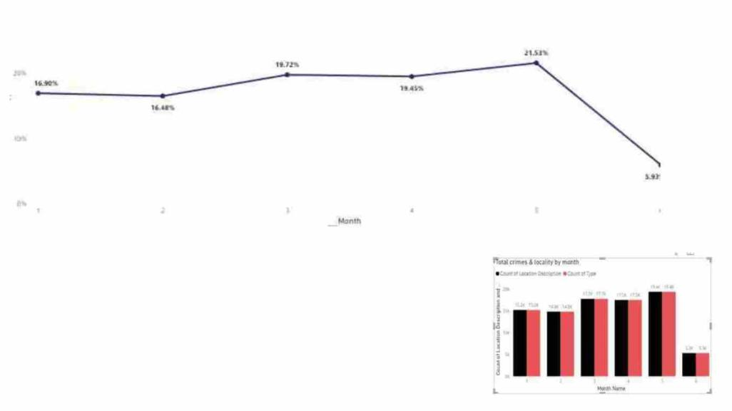
6
BetweenꢀmayꢀandꢀJune,ꢀtheꢀnumberꢀofꢀcrimes
fellꢀbyꢀveryꢀlowꢀsoꢀnextꢀmonthꢀJuly,ꢀtheꢀnumber
ofꢀcrimesꢀcouldꢀbeꢀreducedꢀbyꢀ90%.

Slide 7
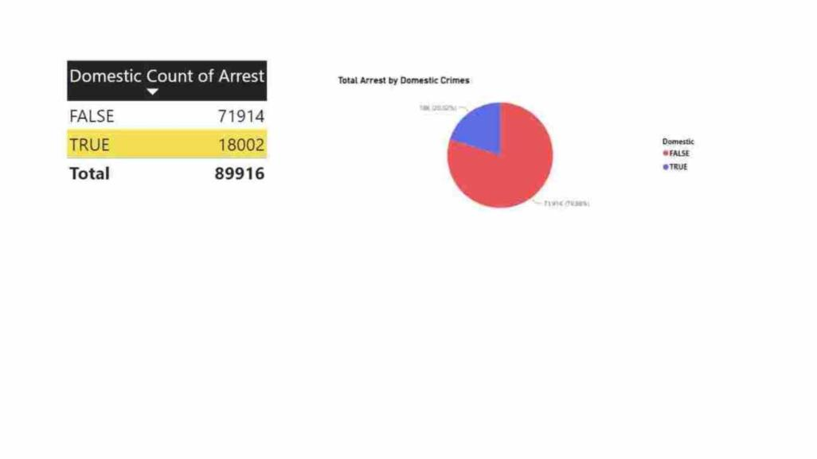
Analysis:
FactorsꢀAffectingꢀArrests:
•
Investigateꢀwhetherꢀpublicꢀhesitationꢀandꢀfamilyꢀpressureꢀareꢀmentionedꢀorꢀdocumentedꢀas
factorsꢀaffectingꢀtheꢀarrestꢀratesꢀforꢀdomesticꢀcrimes.
•
Checkꢀpoliceꢀreports,ꢀwitnessꢀstatements,ꢀorꢀanyꢀrelevantꢀdataꢀsources.
InterviewsꢀorꢀSurveys:
Considerꢀconductingꢀinterviewsꢀorꢀsurveysꢀwithꢀlawꢀenforcement,ꢀvictims,ꢀorꢀcommunity
membersꢀtoꢀgatherꢀinsightsꢀintoꢀpublicꢀhesitationꢀandꢀfamilyꢀpressureꢀimpactingꢀarrests
•

Slide 8
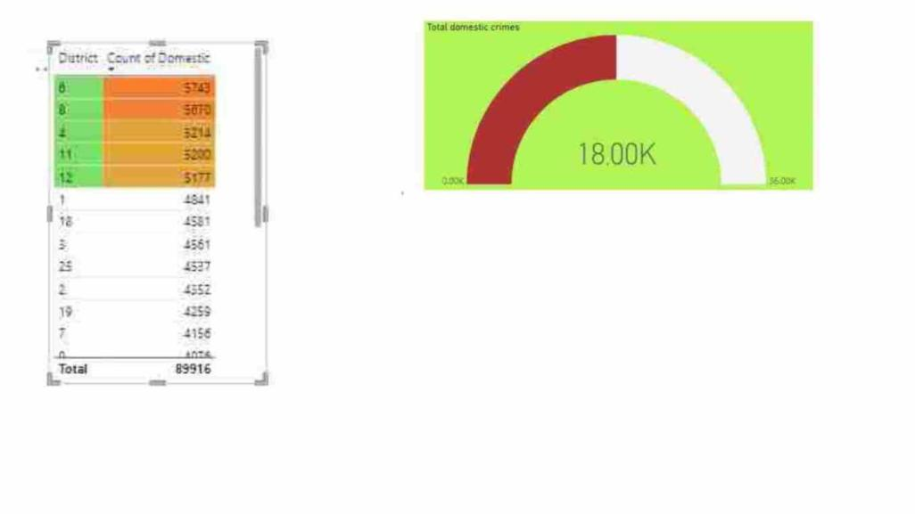
6,8,4,11,12ꢀdistrictsꢀhave
theꢀhighestꢀnumberꢀof
domesticꢀcrimes

Slide 9

Measures to reduce crime rates
1.Social Programs and Youth Engagement:
1. Youth Programs: Invest in after-school programs, mentorship initiatives, and
recreational activities to engage and support young people.
2.Education and Awareness:
1. Crime Prevention Education: Provide educational programs in schools and
communities on crime prevention strategies and personal safety..
2. Job Training Opportunities: Create opportunities for job training and skill
development to empower individuals with better prospects.
3.Economic Development:
1. Job Creation: Support initiatives that create job opportunities, especially in
economically disadvantaged areas.
2. Community Investment: Invest in infrastructure and community development to
improve overall quality of life.

Slide 10
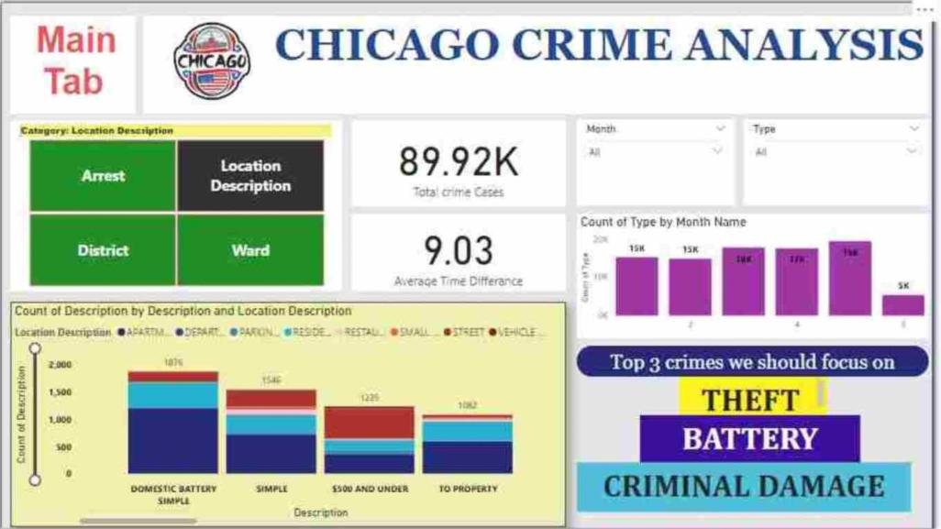

Slide 11
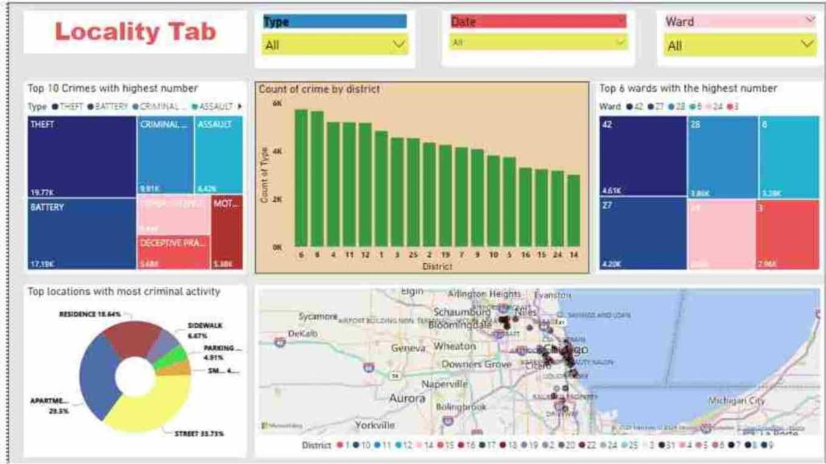

Slide 12
